Slide 1
Basic terminology
DATA:- values or set of values
DATA ITEM:- refers to a single unit of value, further divided into group of items
For eg:- a person’s name cane be divide into 3 sub items, first name , middle name and last name.
Collection of data needs to be stored.
‘information’ term is always used with data and it means meaningful or processed data.

Slide 2
DATA STRUCTURE
A data structure is basically a group of data elements that are put together under one name, and which defines a particular way of storing and organizing data in a computer so that it can be used efficiently.
Some common examples of data structures are
arrays,
linked lists,
queues,
stacks,
binary trees, and
hash tables.

Slide 3
CLASSIFICATION OF
DATA STRUCTURES
Data structures are generally categorized into two classes: primitive and non-primitive data structures.
Primitive and Non-primitive Data Structures
Primitive data structures are the fundamental data types which are supported by a programming language. Some basic data types are integer, real, character, and boolean. The terms ‘data type’, ‘basic data type’, and ‘primitive data type’ are often used interchangeably.
Non-primitive data structures are those data structures which are created using primitive data structures. Examples of such data structures include linked lists, stacks, trees, and graphs.Non-primitive data structures can further be classified into two categories: linear and non-linear data structures.

Slide 4
Linear and Non-linear Structures
If the elements of a data structure are stored in a linear or sequential order, then it is a linear data structure. Examples include arrays, linked lists, stacks, and queues. Linear data structures can be represented in memory in two different ways. One way is to have to a linear relationship between
elements by means of sequential memory locations. The other way is to have a linear relationship between elements by means of links.
If the elements of a data structure are not stored in a linear or sequential order, then it is non linear data structure

Slide 5
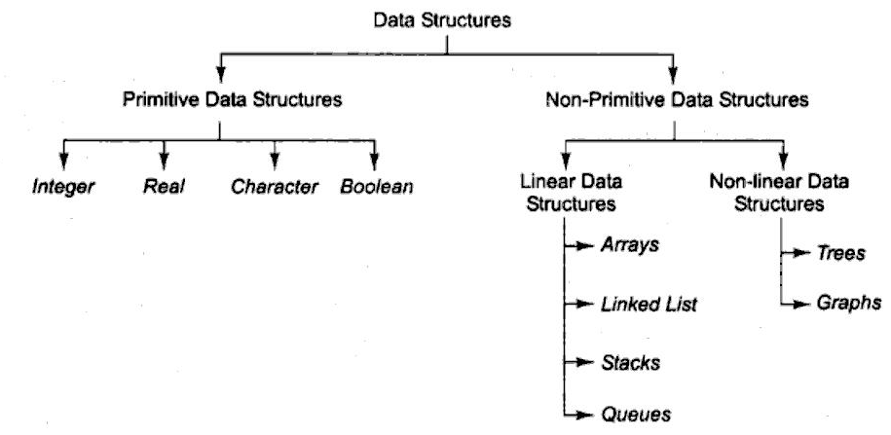

Slide 6
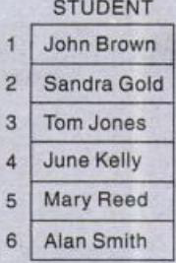
Arrays
An array is a collection of similar data elements. These data elements have the same data type.The elements of the array are stored in consecutive memory locations and are referenced by an index (also known as the subscript).
In C, arrays are declared using the following syntax:
type name[size];

Slide 7
Arrays are generally used when we want to store large amount of similar type of data. But they have the following limitations:
1. Arrays are of fixed size.
2. Data elements are stored in contiguous memory locations which may not be always available.
3. Insertion and deletion of elements can be problematic because of shifting of elements from
their positions.
However, these limitations can be solved by using linked lists

Slide 8
Linked Lists
A linked list is a very flexible, dynamic data structure in which elements (called nodes) form a sequential list. In contrast to static arrays, a programmer need not worry about how many elements will be stored in the linked list. This feature enables the programmers to write robust programs which require less maintenance.
In a linked list, each node is allocated space as it is added to the list. Every node in the list points to the next node in the list. Therefore, in a linked list, every node contains the following two types of data:
1. Info field:-that contains the values of the element
2. A pointer /nextpointer field:-that contains the address of the next node.

Slide 9
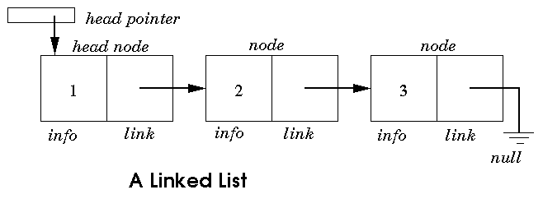
The last node in the list contains a NULL pointer to indicate that it is the end or tail of the list. Since the memory for a node is dynamically allocated when it is added to the list, the total number of nodes that may be added to a list is limited only by the amount of memory available.
Advantage: Easier to insert or delete data elements
Disadvantage: Slow search operation and requires more memory space

Slide 10
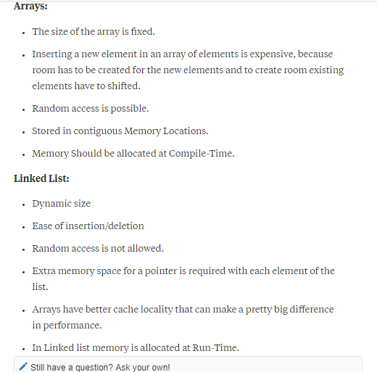

Slide 11
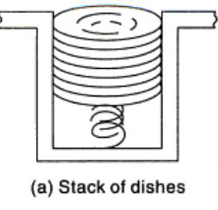
Stacks
A stack is a linear data structure in which insertion and deletion of elements are done at only one end, which is known as the top of the stack. Stack is called a last-in, first-out (LIFO) structure because the last element which is added to the stack is the first element which is deleted from the stack.

Slide 12
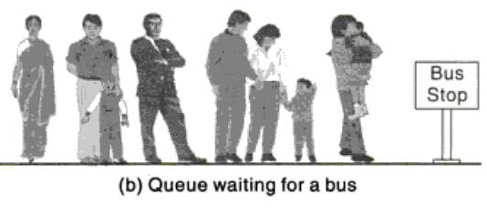
Queues
A queue is a first-in, first-out (FIFO) data structure in which the element that is inserted first is the first one to be taken out. The elements in a queue are added at one end called the rear and removed from the other end called the front. Like stacks, queues can be implemented by using either arrays or linked lists.

Slide 13
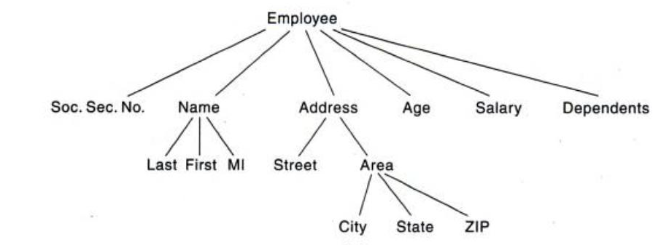
Trees
A tree is a non-linear data structure which consists of a collection of nodes arranged in a hierarchical order. One of the nodes is designated as the root node, and the remaining nodes can be partitioned into disjoint sets such that each set is a sub-tree of the root.
Advantage: Provides quick search, insert, and delete operations
Disadvantage: Complicated deletion algorithm

Slide 14
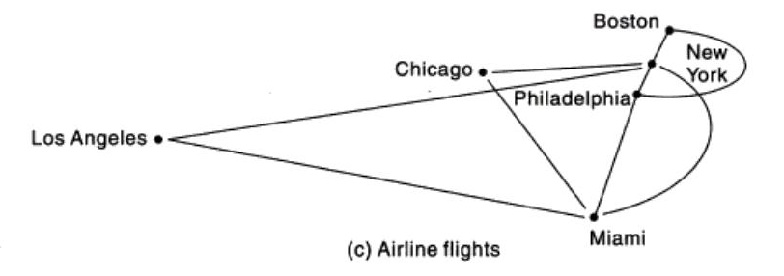
Graphs
A graph is a non-linear data structure which is a collection of vertices (also called nodes) and edges that connect these vertices.G=(V,E).

Slide 15
OPERATIONS ON DATA STRUCTURES
This section discusses the different operations that can be performed on the various data structures
previously mentioned.
Traversing :-It means to access each data item exactly once so that it can be processed. For example, to print the names of all the students in a class.
Searching:- It is used to find the location of one or more data items that satisfy the given constraint.Such a data item may or may not be present in the given collection of data items. For example, to find the names of all the students who secured 100 marks in mathematics.
Inserting :-It is used to add new data items to the given list of data items. For example, to add the details of a new student who has recently joined the course.

Slide 16
Deleting :-It means to remove (delete) a particular data item from the given collection of data items. For example, to delete the name of a student who has left the course.
Sorting:- Data items can be arranged in some order like ascending order or descending order depending on the type of application. For example, arranging the names of students in a class in an alphabetical order, or calculating the top three winners by arranging the participants’ scores in
descending order and then extracting the top three.
Merging :-Lists of two sorted data items can be combined to form a single list of sorted data items.

